Slide 1
Web Dev and Databases Website project
Yazeed Muawiya Moh’d Abu-Hummos
(21014295)

Slide 2
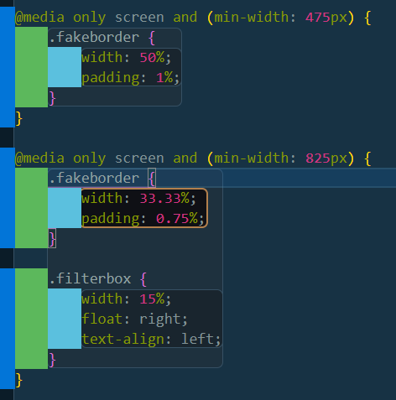
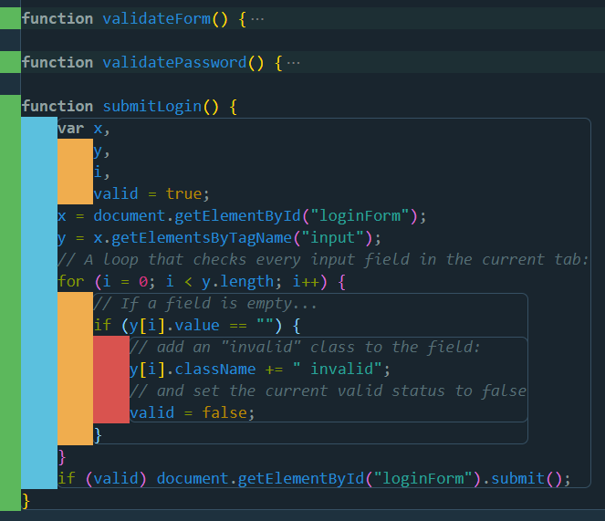
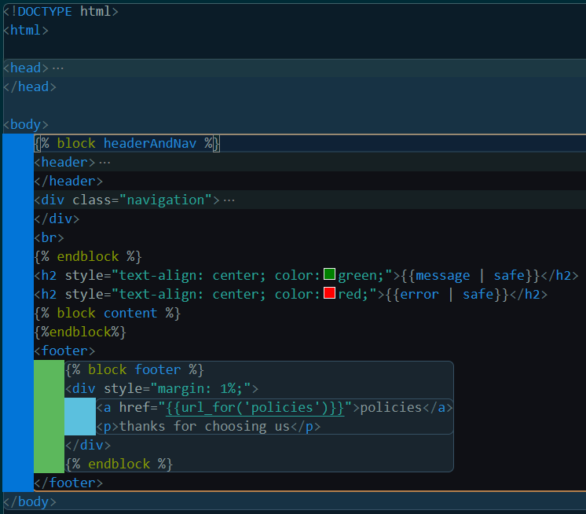
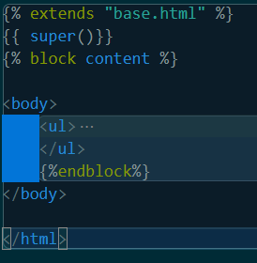
Front-end:
HTML5 and CSS for front-end design
The website is mobile first approach
Media queries were used for a dynamic look on different screen sizes
Java script was used for data validation on client side, in addition to some calculations
A base template was set and called in all webpages for ease of updating the design

Slide 3
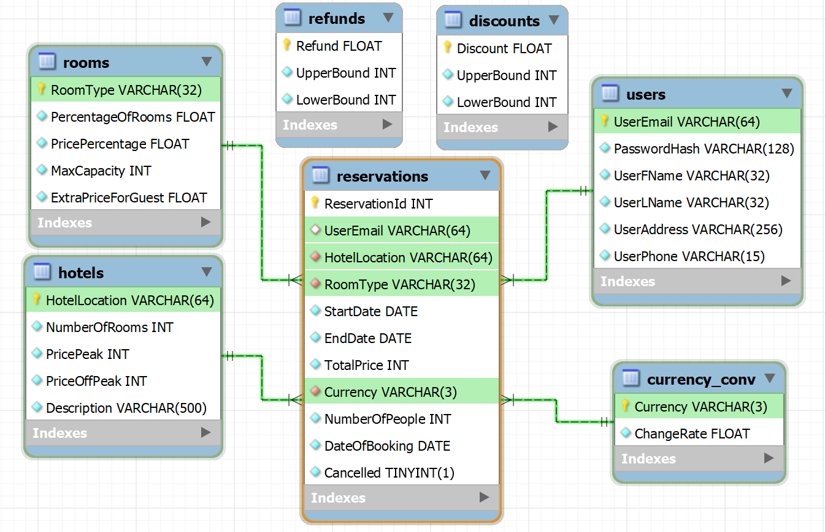
Database:
I have decided on storing most of the numbers and data given to us in tables as that will make for a more dynamic website design rather than hardcoding it, and even some values can be updated from within the website.
My database is in the 1NF as there can’t be repeating groups for one attribute. Furthermore, due to not having any composite keys, the database will automatically be in 2NF. And finally, because we can figure out any of the non-key attributes using another non-key attribute (transitive dependency), meaning my database is now in the 3NF.

Slide 4
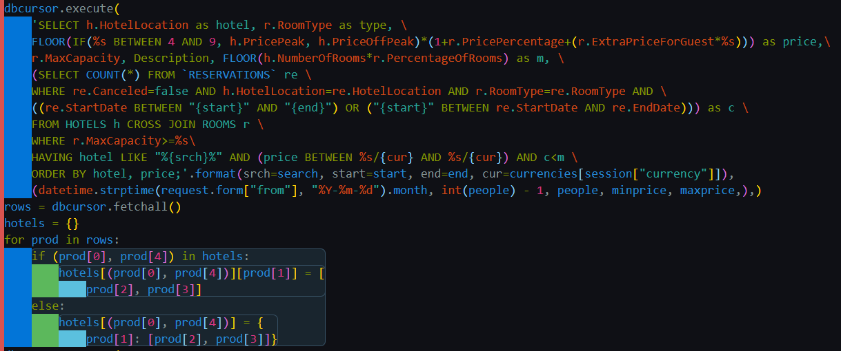
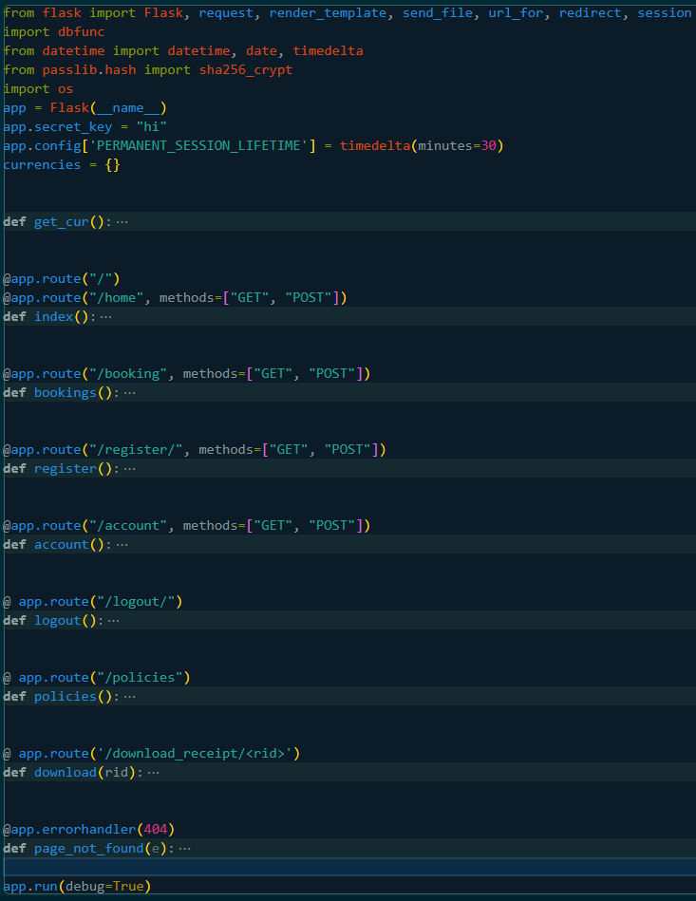
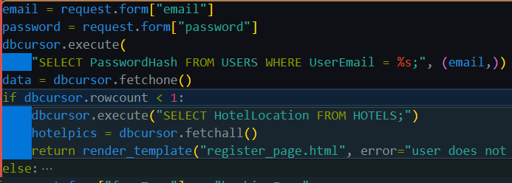
Back-end:
A flask frame-work was used for back-end design
It was the connection point between front-end and the database
Most of the processing and calculations where done here
A little validation was done here because I did not use ajax,
Database manipulation was done here

Slide 5
LESP:
Legal: the images I used are license free. Website is transparent about user data policy. Users can view all hotel prices at any time without the need of signing up.
Ethical: used jpg which is light. No videos were used. Database is hosted on a carbon neutral server. Didn’t have a table to store all rooms to save storage. Labels for inputs. Only have 5 webpages.
Social: works on different screen sizes. Use of autocomplete and labels for people with disabilities. Easy to navigate and simple. The website is cross-platform.
Professional: project meets the functional requirements and have additional features. Organised code. Testing against possible issues a user might face. Error handling.

Slide 6
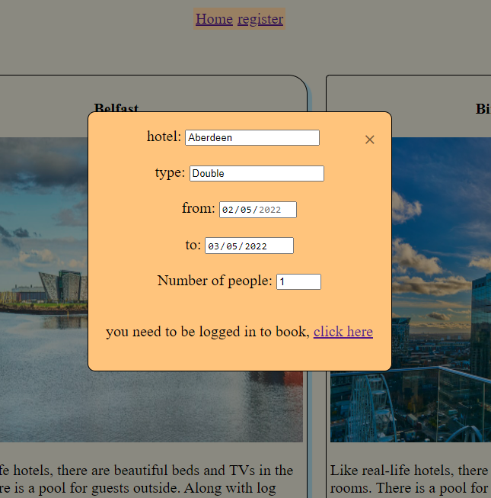
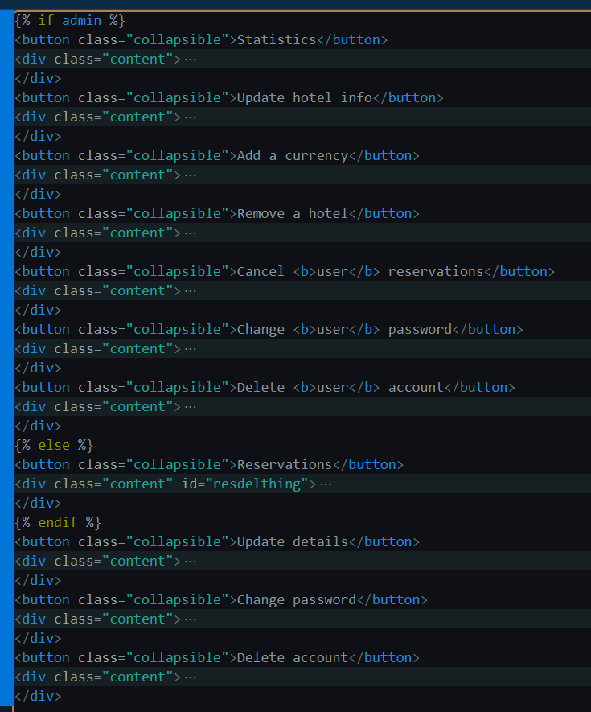
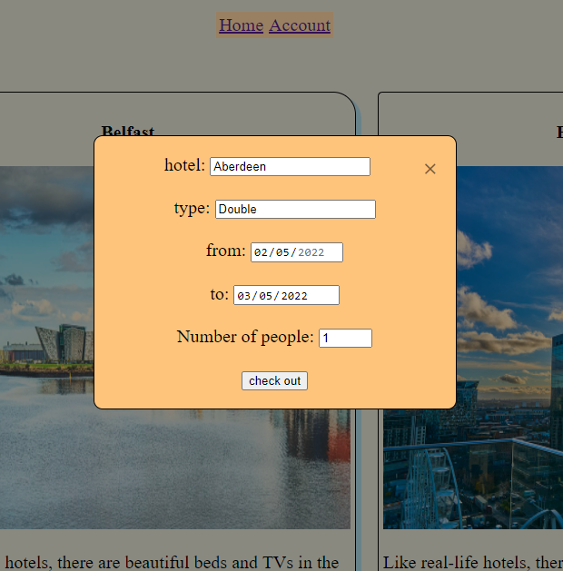
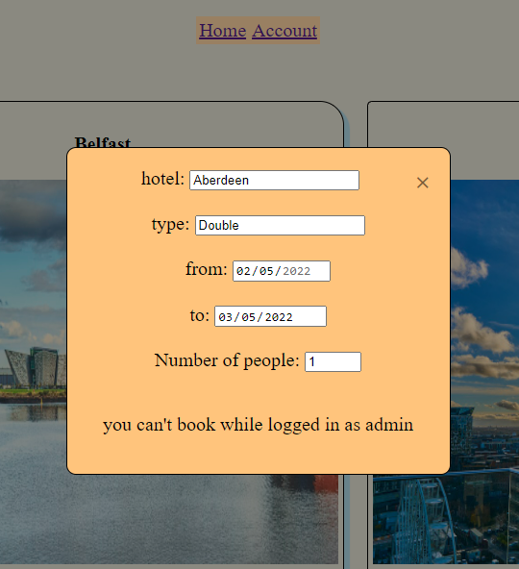
User system:
Users only need an account to book
Admins are identified by an @hhotels.co.uk domain
Password are hashed with salt
Standard and admin page are on the same webpage, and jinja2 was used to separate the features
When a user deletes their account all their data is deleted except for bookings
Users can’t delete their account if they have an upcoming reservation
Admins can’t book, but can still view the hotel prices
Users will be automatically logged out after 30 minutes

Slide 7
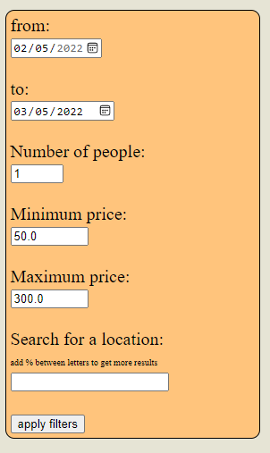
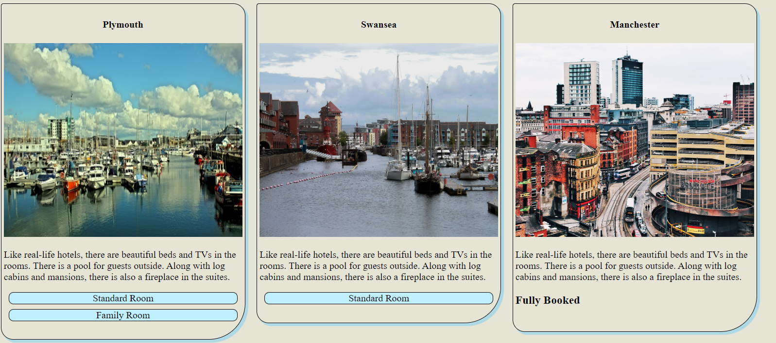
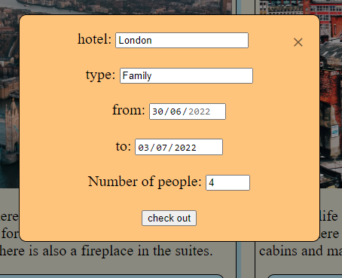
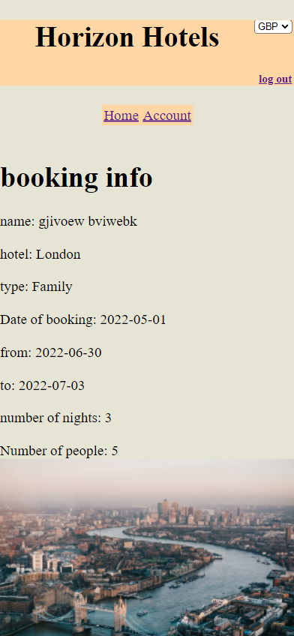
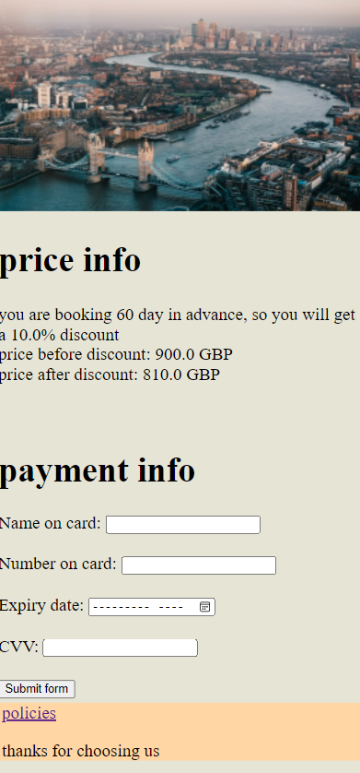
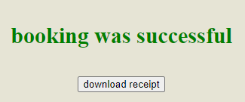
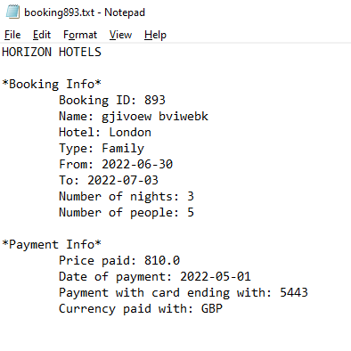
Booking process:
First it starts with the user applying filters about their desired booking, then flask returns all the hotels and rooms that are available, and states if a hotel is fully booked
After choosing a hotel and room type, users are taken to a page with the booking info and any discounts, and is asked for payment info
Finally they’re taken to their account with a message saying hotel is booked and a button to download receipt

Slide 8
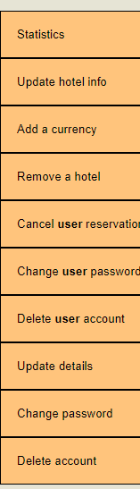
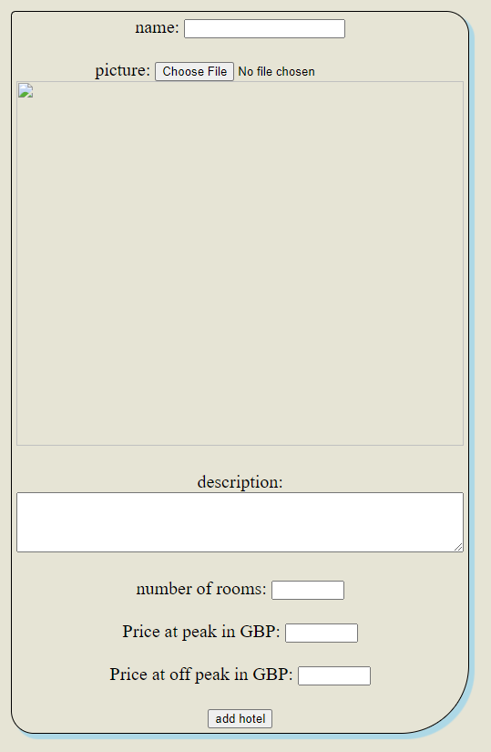
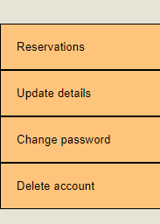
User features:
The website has a total of 12 user features, split between admin and standard
Admin features: add hotels, statistics, update hotel info, add a currency, remove a hotel, cancel user reservation, change user password and delete user account
Standard user features: view and cancel reservations
Shared features: update details, change password and delete account

